Slide 1
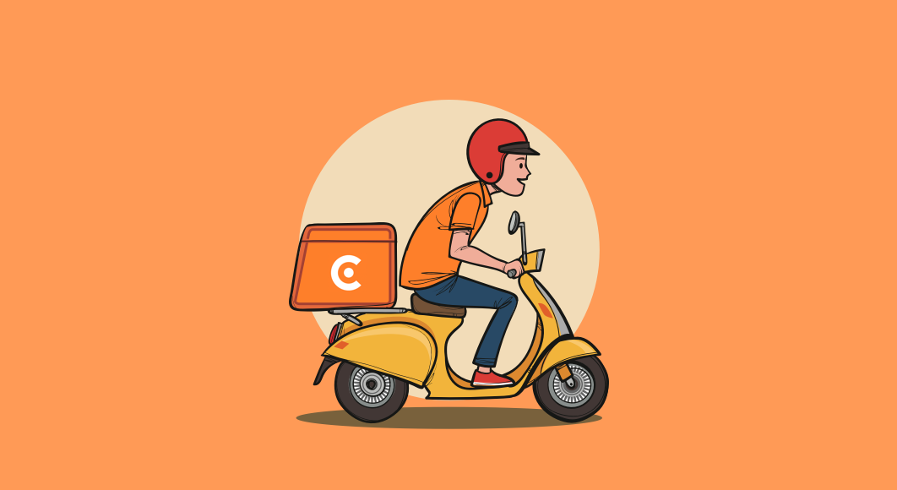
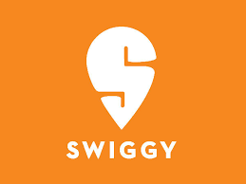
SWIGGY
Presented by:
Pooja Gurav
Mukta Wagh
Samruddhi Dasharath
Srushti Jadhav
Harashal Chaudhari
Rutuja Ghagare

Slide 2
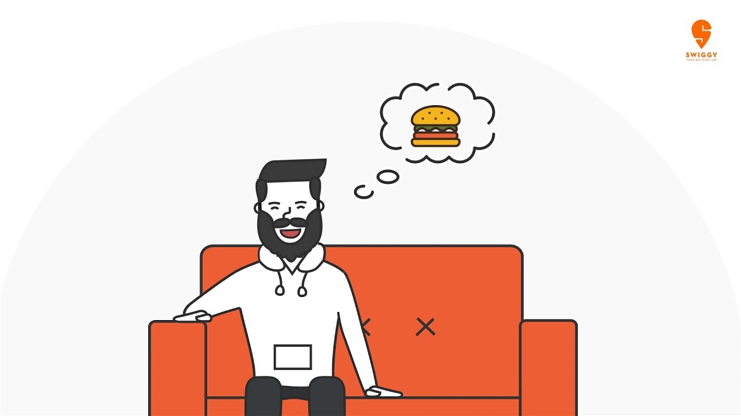
TABLE OF CONTENTS
About Swiggy.com
Process flow
❖ Business Model of Swiggy
Food Delivery Dimensional Model
OLTP
Dimension and Fact Tables
Analytics

Slide 3

About Swiggy
Swiggy is an Indian online food ordering and delivery platform. Founded in July 2014.
Swiggy is based in Bangalore and operates in 500 Indian cities as of September 2021.
It has its own fleet of delivery boys who are equipped with smartphones and the Swiggy app, which helps the user to track their delivery through routing algorithms.
Swiggy offers an online ordering platform for a variety of listed neighborhood partner restaurants and their fleet of delivery personnel who pick up orders from the partner restaurants and deliver them to customers' doorsteps

Slide 4
Process flow
Order is Placed By customer
Order is sent to the restaurant
Delivery Employee is assigned for the order
Delivery Employee delivers the food items
Delivery Employee picks the order items

Slide 5
Success story and Motivation
In 2013 two founders, Sriharsha Majety and Nandan Reddy designed an e-commerce website called “Bundl” to facilitate courier service and ship goods within India.
Bundl was quickly paused, and they moved into the food delivery market.
The company built out a dedicated delivery network and grew rapidly, primarily driven by the focus on logistics and locking in key resources.
Swiggy began its Journey from Bengaluru with six delivery executives and 25 restaurants on its platform.
In the time of 3 years, it has scaled up with over 6,000 delivery executives across India in more than 8 cities like Delhi-NCR, Mumbai, Bengaluru, Hyderabad, Chennai, Kolkata, and Pune.

Slide 6
Business Model
A single point of contact platform provided by Swiggy.
Food can be ordered directly from nearby restaurants and delivered to the doorstep via their app. There is a wide selection of restaurants and their menus with prices displayed within the app for ordering.
Customer– Users can download the Swiggy app on their phones once they are registered Swiggy users. Using the Swiggy app, they can place an order for food.
As the Order approaches, users can track it on their phones.
Fees and Payments - Swiggy charges based on type of order, distance, peak hour, and payment method, Credit Card or Cash on Delivery.
15-25% commission on total order bill (inclusive of Goods and Service Tax) from restaurants

Slide 7
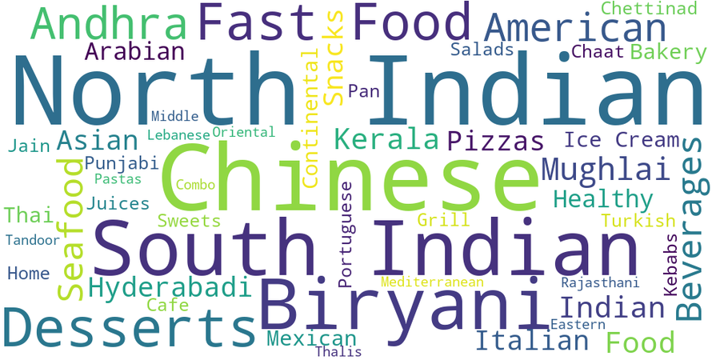
Food That Is Usually Ordered By Customers

Slide 8
The Swiggy app is rated by | customers

Slide 9
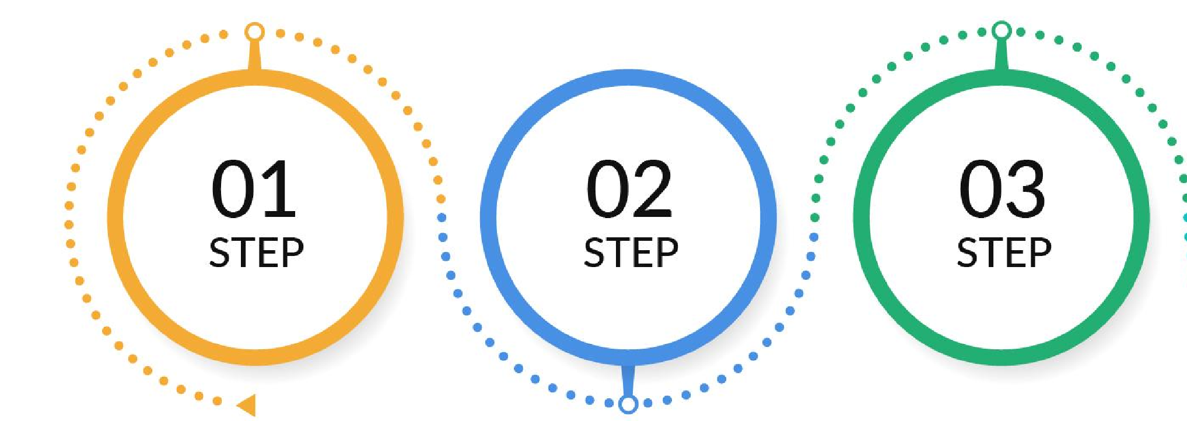
Food Delivery Dimensional Model
Reporting and Complex Queries
OLTP System
Creating Dimensional Model

Slide 10
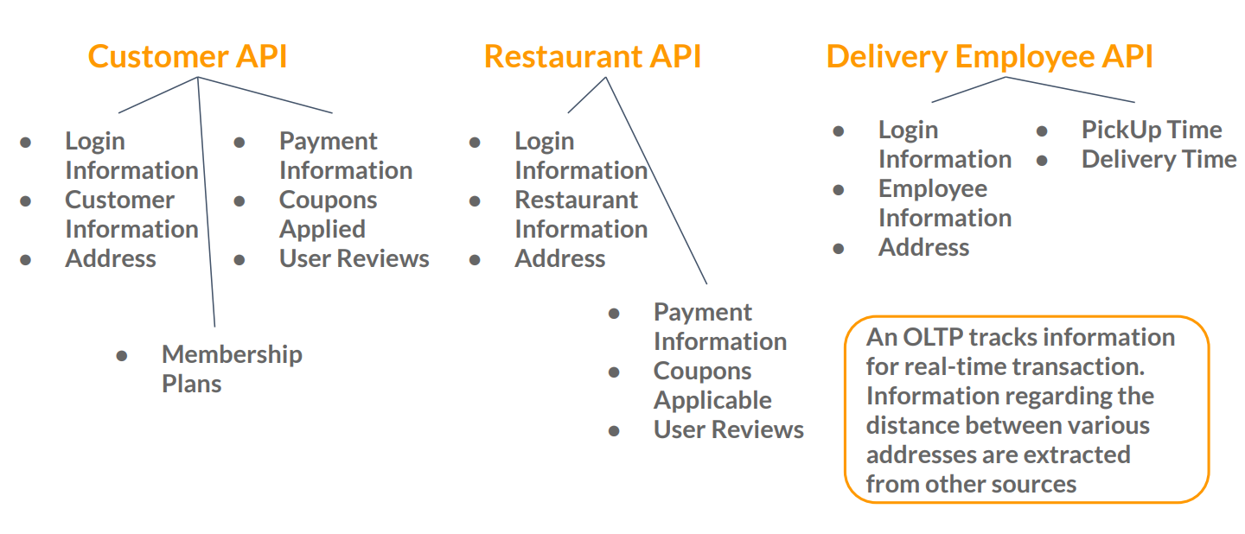
OLTP | Food Delivery Source Data Distribution
There are three main interfaces from which the data is collected in an OLTP system

Slide 11
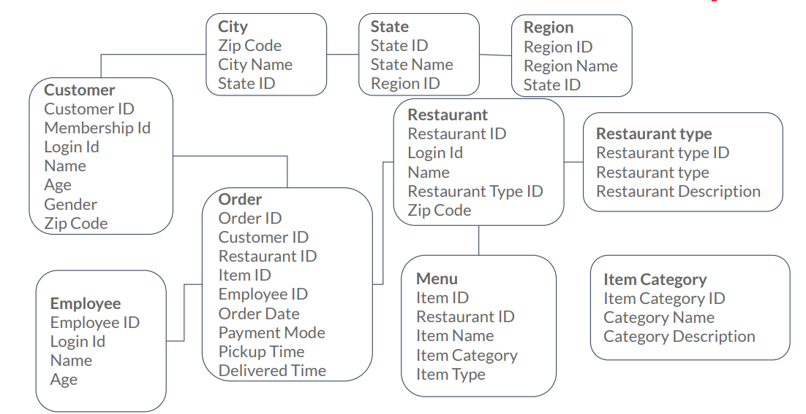
OLTP | A Relational Model

Slide 12

Dimensional Model | Process and Grain
Sales
Process:
The Company wants to track orders placed on their application.
Grain:
The company wants to track atomic data regarding every food item sold.
If two different items are sold in one transaction, the number of rows will be 2.

Slide 13
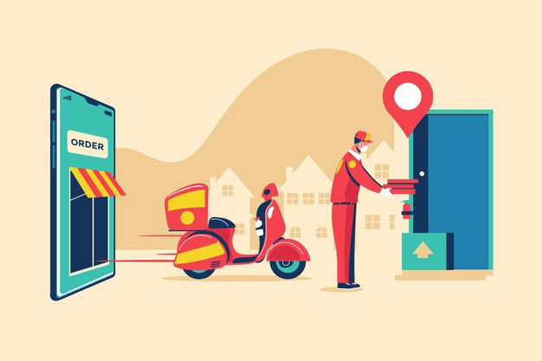
Delivery
Process: The Company wants to track delivery information regarding the orders that are placed.
Grain: The grain is the atomic data regarding every transaction. For every transaction, there is one row only.

Slide 14
Sales Dimensional Model | Dimensions
Date Dimension
Date ID
Date
Month
Year
Month in number
Day
Weekend or Weekday
Holiday
Week Number
Quarter
Customer Dimension
Customer ID
Login ID
Name
Age
Gender
Date of joining
Address
State
Zip Code
Restaurant Dimension
Restaurant ID
Login Id
Name
Category
Date of joining
Membership plan
Address
State
Zip Code
Food item Dimension
Food Item ID
Food Item Name
Food Item Category
Food Item Type
Preparation Time
Food Item Initial Price
Food Item Description

Slide 15
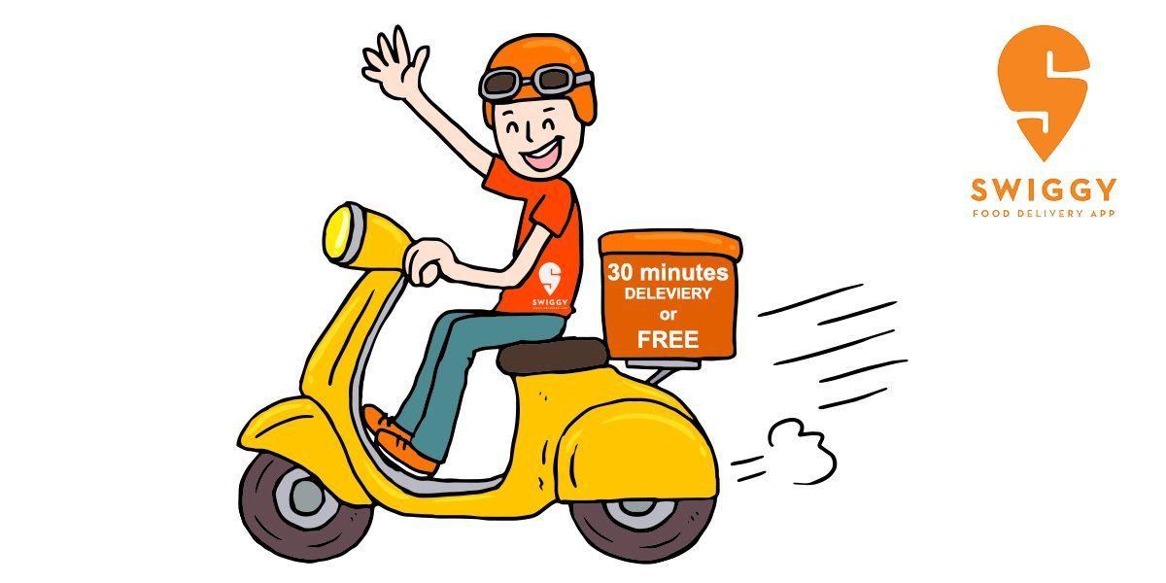
| Facts
Sales Fact Table
Date ID
Customer ID
Restaurant ID
Item ID
Quantity ordered
Initial Price
Coupon Discount
Final Price

Slide 16
Sales Dimensional Model | Star Schema
Date Dimension
Customer Dimension
Sales Fact Table
Date ID
Customer ID
Date ID
Date
Login ID
Customer ID
Month
Name
Year
Restaurant ID
...
...
Item ID
Quantity ordered
Restaurant Dimension
Initial Price
Food item Dimension
Restaurant ID
Coupon Discount
Food Item ID
Login Id
Name
Final Price
Food Item Name
...
...

Slide 17
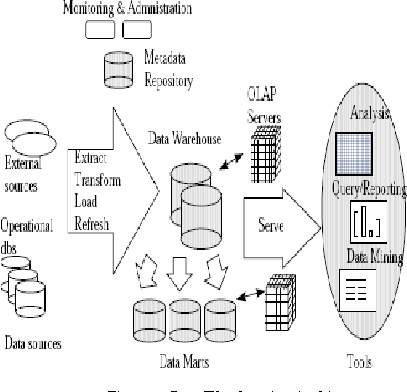
OLAP | Architecture.

Slide 18
Reporting Analytics for Sales
Sales across the Date Dimension
Quarter
Sales
Quarter
Month
Sales
Q1
100000
Q1
April
20000
Drill Down into detail
Q2
150000
Q1
May
30000
Q3
120000
Q1
June
50000
Drill Down into
detail
Quarter
Month
Day
Sales
Q1
April
Weekdays
15000
Q1
April
Weekends
5000

Slide 19
Reporting Analytics for Sales
State | Sales
KR | 30000
MR | 40000
MP | 50000
State
District
Sales
KR
Mys
10000
Drill Down into detail
KR
Ban
5000
KR
Bel
15000

Slide 20
Delivery Dimensional Model
Facts
Dimensions
Delivery Fact Table
Date ID
Customer ID
Restaurant ID
Delivery Employee ID
Pickup Time
Delivered Time
Total Delivery Time
Delivery Employee Dimension
Delivery Employee ID
Login Id
Name
Age
Phone Number
Address
All the other dimension tables are already made for Sales Fact Table and can be used here.

Slide 21
Delivery |Star Schema
Date Dimension
Customer Dimension
Delivery Fact Table
Date ID
Customer ID
Date ID
Date
Login ID
Customer ID
Month
Name
Year
Restaurant ID
...
...
Delivery Employee ID
Restaurant Dimension
Pickup Time
Delivered Time
Delivery Employee Dimension
Restaurant ID
Login Id
Total Delivery Time
Delivery Employee ID
Name
Login ID
...
...

Slide 22
Reporting Analytics for Delivery Average time across the Restaurant Region
State | Average Time per Delivery(min)
KR | 30
MR | 40
MP | 25
State
District
Average
Time per
Drill Down into detail
Delivery
KR
Mys
30
KR
Ban
40
KR
Bel
20

Slide 23
A Sample of Data Warehouse | Sales and Delivery
Customer
Date
Customer
Dimension
Dimension
Dimension
Sales Fact Table
Delivery Fact Table
Food Item
Restaurant
Employee
Dimension
Dimension
Dimension

Slide 24
Reference
https://www.swiggy.com/
https://bstrategyhub.com/swiggy-business-model-how-does-swiggy-make-money/
https://jungleworks.com/swiggy-business-model-explained-2/
https://whatisthebusinessmodelof.com/business-models/swiggy-business-model/

Slide 25
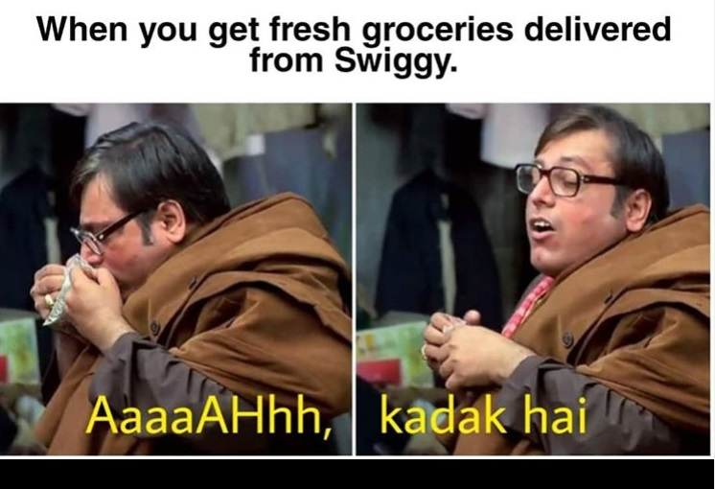

Slide 26
https://www.youtube.com/watch?v=GmsWXkQmjX8

Slide 27
THANK YOU
'Swiggy Karo, Phir Jo Chahe Karo!

